Slide 1
INTERFACING WATER SENSOR AND RASPBERRY PI
GROUP 3
NIBIN SOBY
C0741660

Slide 2

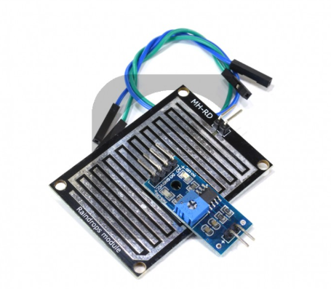
WATER SENSOR
This sensor which helps to sense the wet substance
This water sensor have a series of exposed traces connected to ground
When water is present the ground traces will connect with the sensing traces.

Slide 3
SPECIFICATIONS
Operating Voltage: 3.3 to 5V
Output: Analog & Digital
Dimensions: 3.2cm x 1.4cm
There is an on-board LM393 comparator,which helps to get both analog or digital signal

Slide 4
USE IN OUR PROJECT
Moisture sensor is used to detect the water content in the garbage thus helps to differentiate between wet and dry waste
The sensor will output a HIGH signal when there is water

Slide 5
INTERFACING –OBJECTIVE
Components Used
Raspberry pi
Water Sensor
Buzzer
LED
Here I am trying to establish the communication between Water sensor and Raspberry Pi, and the interfacing can be indicated by a LED and a Buzzer.

Slide 6
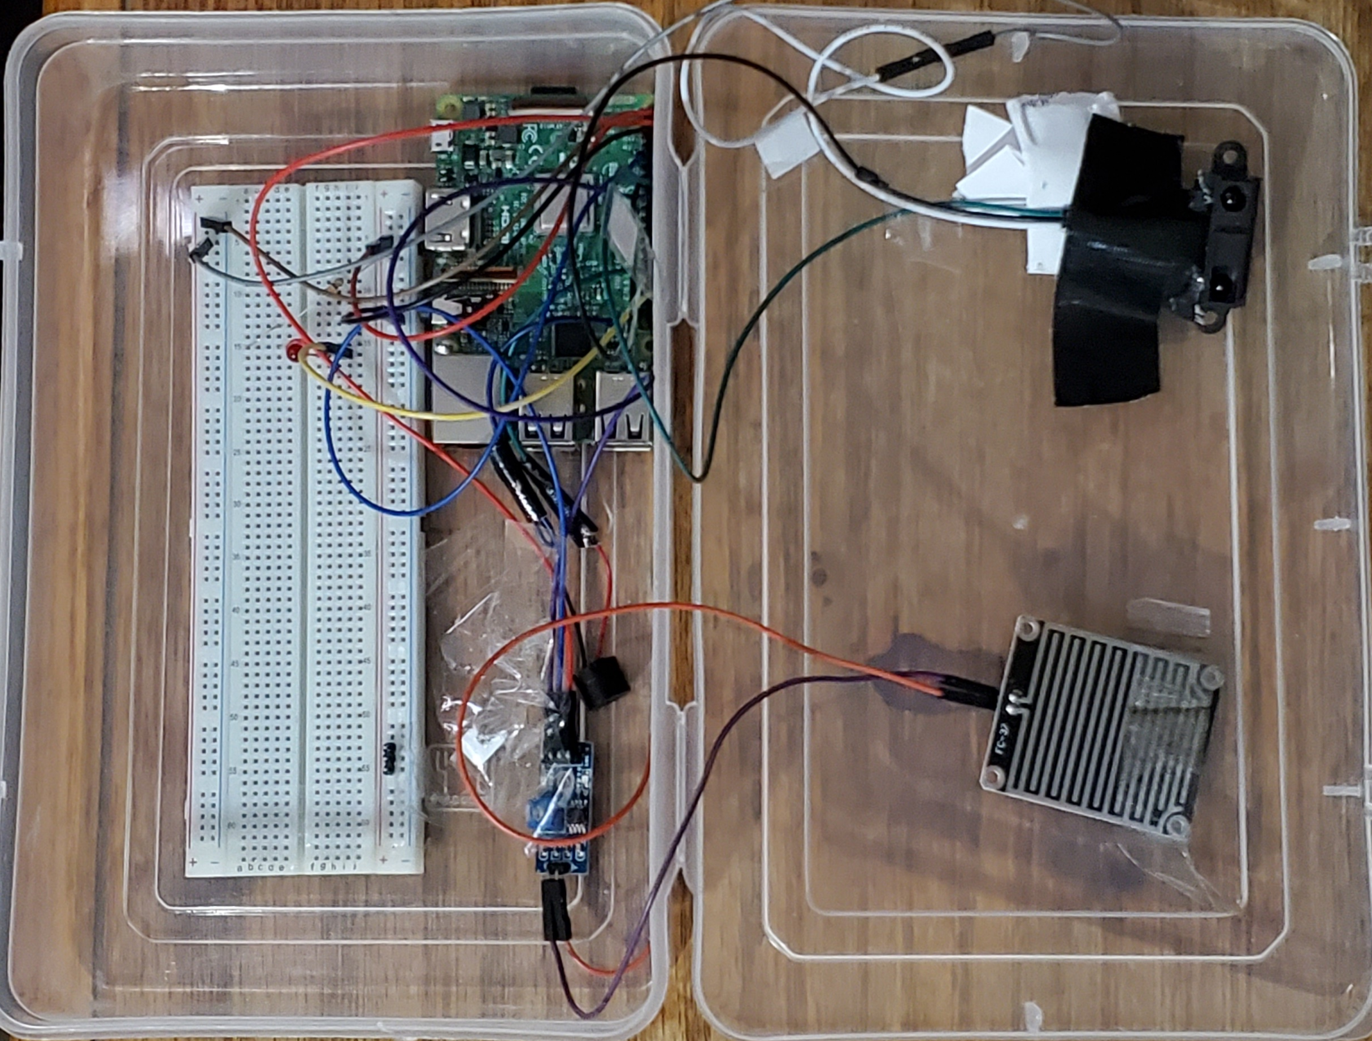
CONNECTION
Water Sensor And Raspberry Pi
VCC Connected to 5v
Ground Connected to Ground
Vout is connected to GPIO 24
LED and Raspberry Pi
Pin 1 connected to Ground
Pin 2 connected to GPIO 16
Buzzer and Raspberry Pi
Pin 1 connected to ground
Pin 2 Connected to GPIO 12

Slide 7
Code
#include <stdio.h>
#include <wiringPi.h> // to access gpio pins
#include <wiringPiI2C.h> // to access gpio pins
#include <fstream> // to store updated file
#include <iostream> // basic input output
#include <thread>
#include <chrono>
const int led = 16; // pin number of led
const int WaterSensor = 24; // pin number of water sensor
const int buzzer = 12;
uint8_t LastStatus = 1;
uint8_t EmergencyStop= 21; // to stop in case of error

Slide 8
Code
int main(void)
{
wiringPiSetupGpio();
pinMode(led, OUTPUT);
pinMode(buzzer, OUTPUT);
pullUpDnControl(proximity,PUD_DOWN); //pullupdown control for IR Sensor
pullUpDnControl(EmergencyStop,PUD_DOWN); //Pullupdown control if there is an emergency stop is needed
for(int i=0; i<2; i++)
{
digitalWrite(buzzer, HIGH);
digitalWrite(led, HIGH);
delay(100);
digitalWrite(led, LOW);
digitalWrite(buzzer, LOW);
delay(100);
}

Slide 9
Code
while (1)
{
if(digitalRead(WaterSensor) && LastStatus==0) //&& this " AND " operator and reads the and value from inpu
{
digitalWrite(led, LOW);
digitalWrite(buzzer, LOW);
LastStatus = 1;
}
else if(!digitalRead(WaterSensor) && LastStatus==1) // digitalRead()= reads the value from input pin
{
digitalWrite(led, HIGH); // write led and buzzer value to high and low
digitalWrite(buzzer, HIGH);
LastStatus = 0;
}

Slide 10
Code
if(digitalRead(EmergencyStop))
{
break;
}
}// end of while loop
}

Slide 11
Steps
Hardware connection are made
Connection to raspberry pi is established and Raspbian os is launched using VNC viewer
Code has been written in Geany in Raspbian,and saved the code as watersensor.c
Then Code has been compiled and executed in terminal
COMPILING CODE
pi@raspberrypi:~ $ g++-9.1 -std=c++17 -Wall -pedantic -lwiringPi watersensor.c -o watersensor
EXECUTING CODE
pi@raspberrypi:~ sudo $ ./ watersensor

Slide 12
Results
The code has been compiled and executed successfully in terminal
The LED and Buzzer made indications when water sensor detect the wet object
Thus the Interfacing between the water sensor and Raspberry pi has been made Sucessfully.

Slide 13
Video Link:
https://www.youtube.com/watch?v=plB-9f2X6pQ&feature=youtu.be
GitHub link :
https://github.com/NibinSoby/WaterSensor/blob/master/Watersensor.c

Slide 14
REFERENCE
https://www.creatroninc.com/product/water-rain-sensor/
https://www.raspberrypi.org/forums/viewtopic.php?t=177161
https://www.raspberrypi.org/products/raspberry-pi-3-model-b/
https://www.rototron.info/raspberry-pi-analog-water-sensor-tutorial/

